Slide 1

Project Methods and Professionalism
Project Management - Risk
How well do we identify and manage risk?
ECU Copyright 2015– CSG 2344 School of Computer and Security Science

Slide 2
Lecture objectives
To be able to understand the following concepts :
Risk Identification
Risk Quantification & Estimation
Risk Evaluation & Prioritisation
Risk Mitigation
Risk Monitoring and control
ECU Copyright 2015– CSG 2344 School of Computer and Security Science

Slide 3
The Importance of Project Risk Management
Project risk management is the art and science of considering
  What risks could disrupt the project,
  What effect would they have,
  What can be done about them
throughout the life of a project and in the best interests of meeting project objectives.
ECU Copyright 2015– CSG 2344 School of Computer and Security Science

Slide 4
Risk Management
Risk: “ to expose to the chance of injury or loss”.
Risk is concerned with the future.
Risk involves a level of uncertainty.
Software Engineering Process
Total Ignorance
Complete Knowledge
Uncertainty
Certainty
ECU Copyright 2015– CSG 2344 School of Computer and Security Science
Notes:
5
The word risk derives from risque ‘ became the word for a joke that risks offending.
Note that CHANCE is involved. Ie ingesting 5 grams of cyanide is not a risk. It is a certainty that it will kill you.
The idea is that in the SE process one moves from ignorance to knowledge and that is why risk management is performed. Face the risks and deal with them.

Slide 5
Risks vs Problems
A problem is NOT a risk.
It is a risk that has occurred
ECU Copyright 2015– CSG 2344 School of Computer and Security Science

Slide 6
Risk Management Types
Reactive
  Mitigation of symptoms.
  Fix on failure.
  Crisis Management.
Proactive
  Elimination of error & root causes.
  Anticipation of failure.
  Management of change.
ECU Copyright 2015– CSG 2344 School of Computer and Security Science
Notes:
7

Slide 7
The risk principle :
If you don’t actively attack the risks, they will actively attack you.
        Tom Gilb.
ECU Copyright 2015– CSG 2344 School of Computer and Security Science

Slide 8
Risk Questions
What are the risks ?
What is the probability of loss from them ?
How much are the losses likely to cost ?
What might be the losses be if the worst happened ?
What alternatives are there ?
How can the losses be reduced or eliminated ?
Will the alternatives produce other risks ?
Notes:
8

Slide 9
Risk Management
Start Here
Risk Identification & Documentation
Risk Monitoring
Risk Planning, Auditing & Database Update
Risk Quantification
& Estimation
Risk Mitigation
Risk Evaluation & Prioritisation
ECU Copyright 2015– CSG 2344 School of Computer and Security Science

Slide 10
Risk Identification
Risk identification is the process of understanding what potential events might hurt or enhance a particular project.
Risk identification tools and techniques include:
  Brainstorming
  The Delphi Technique
  Interviewing
  SWOT analysis
  Ishikawa diagram
  Reviewing previous projects Lessons Learned reports
ECU Copyright 2015– CSG 2344 School of Computer and Security Science

Slide 11
Brainstorming
Brainstorming is a technique by which a group attempts to generate ideas or find a solution for a specific problem by amassing ideas spontaneously and without judgment.
An experienced facilitator should run the brainstorming session.
Be careful not to misuse brainstorming.
  Group effects can inhibit idea generation.
ECU Copyright 2015– CSG 2344 School of Computer and Security Science

Slide 12
Delphi Technique
The Delphi Technique is used to derive a consensus among a panel of experts who make predictions about future developments.
Provides independent and anonymous input regarding future events.
Uses repeated rounds of questioning and written responses and avoids the biasing effects possible in oral methods, such as brainstorming.
ECU Copyright 2015– CSG 2344 School of Computer and Security Science

Slide 13
Interviewing
Interviewing is a fact-finding technique for collecting information in face-to-face, phone, e-mail, or instant-messaging discussions.
Interviewing people with similar project experience is an important tool for identifying potential risks.
ECU Copyright 2015– CSG 2344 School of Computer and Security Science

Slide 14
SWOT Analysis
SWOT analysis
  strengths,
  weaknesses,
  opportunities,
  threats
Helps identify the broad risks that apply to a project.
ECU Copyright 2015– CSG 2344 School of Computer and Security Science

Slide 15
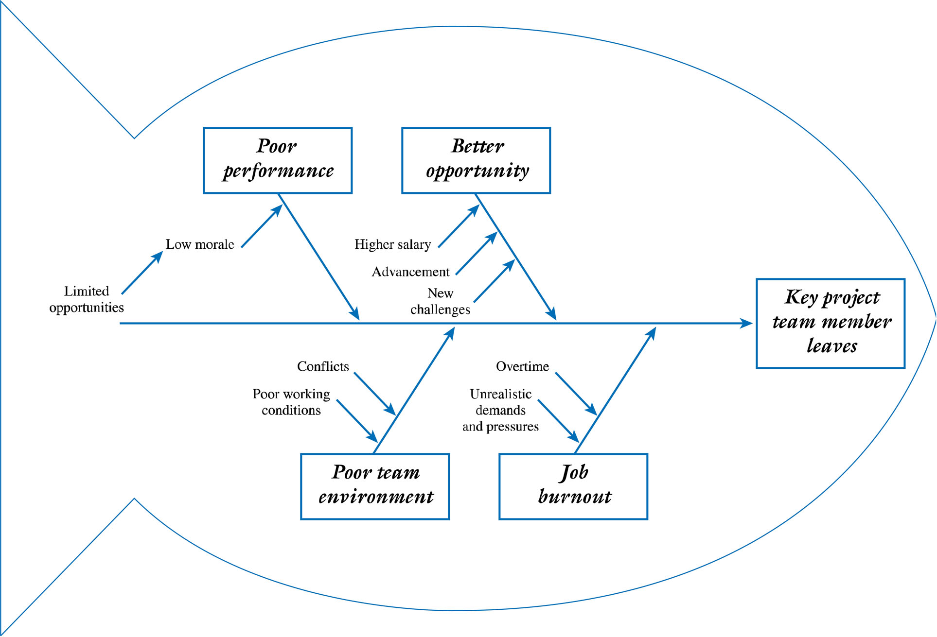
Cause and Effect Diagram
ECU Copyright 2015– CSG 2344 School of Computer and Security Science

Slide 16
Risk Identification
A risk breakdown structure is a hierarchy of potential risk categories for a project.
Similar to a work breakdown structure but used to identify and categorize risks.
ECU Copyright 2015– CSG 2344 School of Computer and Security Science

Slide 17
Potential Areas of Risk
Technical
Organisational
Project management
Users
Installation issues
Operations and support
ECU Copyright 2015– CSG 2344 School of Computer and Security Science
Notes:
19

Slide 18
Risk Estimation
Organise these risks to your life in descending order:
  being shot by a stranger...
  drowning in the bath...
  plane crash...
  car accident...
  suicide...
  accidental fall...
  cancer...
ECU Copyright 2015– CSG 2344 School of Computer and Security Science

Slide 19
The Real Risks
Chances are your death will be by:
  plane crash...
    1 in 800,000
  being shot by a stranger...
    1 in 22,500
  drowning in the bath...
    1 in 17,500
Chances are your death will be by:
  car accident...
    1 in 300
  suicide...
    1 in 160
  accidental fall...
    1 in 150
  cancer...
    1 in 4
ECU Copyright 2015– CSG 2344 School of Computer and Security Science

Slide 20
Risk Estimation and Quantification
Probablility of risk occurrence
  Nominate a scale eg
    High
    Medium
    low
Impact of risk occurrence
  Probability * cost if risk occurs
  Or nominate a scale as above
ECU Copyright 2015– CSG 2344 School of Computer and Security Science

Slide 21
Risk Estimation and Quantification
Each risk item classified according to the probability of occurrence on a scale eg of 0 to 1, low to high
Project impact of each item assessed in financial terms
Risk probability * impact = expected cost
xxxx 0.1 $20,000 $2,000
ECU Copyright 2015– CSG 2344 School of Computer and Security Science

Slide 22
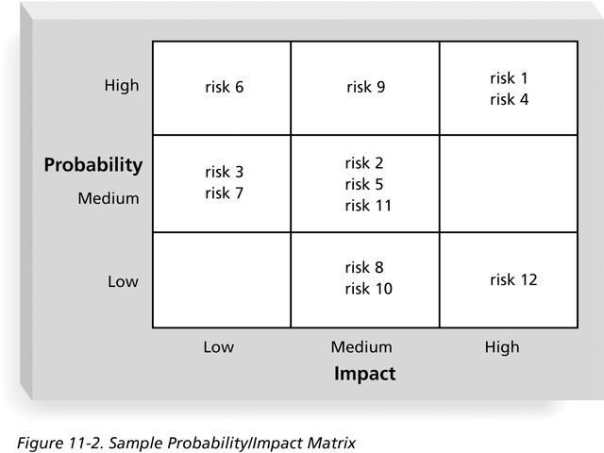
Risk Evaluation - Probability/Impact Matrix
ECU Copyright 2015– CSG 2344 School of Computer and Security Science

Slide 23
Risk Mitigation Response Planning
After identifying and quantifying risks, you must decide how to respond to them.
Main response strategies for negative risks:
  Risk acceptance
  Risk mitigation
    Clearly defined strategies to avert high priority risks from occurring
ECU Copyright 2015– CSG 2344 School of Computer and Security Science

Slide 24
Risk Register
The main output of the risk identification process is a list of identified risks and other information needed to begin creating a risk register
A risk register is:
  A document that contains the results of various risk management processes and that is often displayed in a table or spreadsheet format
  A tool for documenting potential risk events and related information
Risk events refer to specific, uncertain events that may occur to the detriment or enhancement of the project
ECU Copyright 2015– CSG 2344 School of Computer and Security Science

Slide 25
Risk Register Contents
An identification number for each risk event
A rank for each risk event
The name of each risk event
A description of each risk event
The category under which each risk event falls
The root cause of each risk
ECU Copyright 2015– CSG 2344 School of Computer and Security Science

Slide 26
Risk Register Contents (continued)
Triggers for each risk; triggers are indicators or symptoms of actual risk events
Potential responses to each risk
The risk owner or person who will own or take responsibility for each risk
The probability and impact of each risk occurring
The status of each risk
ECU Copyright 2015– CSG 2344 School of Computer and Security Science

Slide 27
Risk Monitoring and Control
Top Ten Risk Item Tracking helps to identify current risks and maintain an awareness of risks throughout the life of a project.
Establish a periodic review of the top ten project risk items.
List the current ranking, previous ranking, number of times the risk appears on the list over a period of time, and a summary of progress made in resolving the risk item.

Slide 28
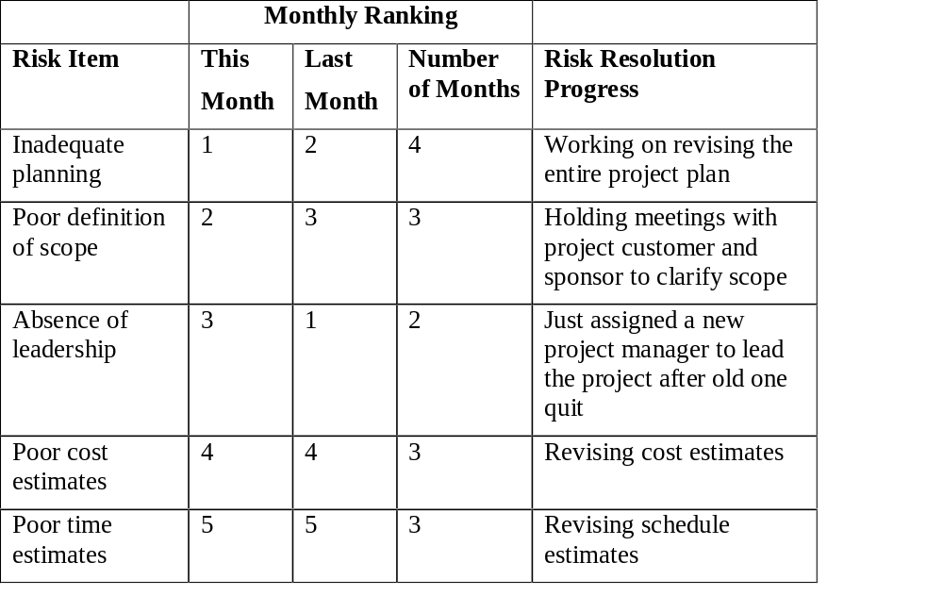
Risk Tracking

Slide 29
Benefits of Risk Management.
Allows for pro-active and not reactive management.
Consistent & systematic view of the problem domain.
Improved credibility of plans and provides justification for decisions made.
Provides a feedback mechanism to prevent or avoid risks.
A means to identify opportunities.
Confidence in decision making.
ECU Copyright 2015– CSG 2344 School of Computer and Security Science
Notes:
21

Slide 30
Risk Management Planning
The main output of risk management planning is a risk management plan—a plan that documents the procedures for managing risk throughout a project.
The project team should review project documents and understand the organization’s and the sponsor’s approaches to risk.
The level of detail will vary with the needs of the project.
ECU Copyright 2015– CSG 2344 School of Computer and Security Science

Slide 31
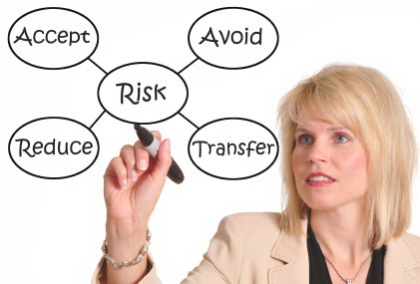
Topics Addressed in a Risk Management Plan
Methodology
Roles and responsibilities
Risk categories
Risk probability and impact
Risk Mitigation strategies
Risk documentation requirements
ECU Copyright 2015– CSG 2344 School of Computer and Security Science

Slide 32
Results of Good Project Risk Management
Unlike crisis management, good project risk management often goes unnoticed.
Well-run projects appear to be almost effortless, but a lot of work goes into running a project well.
Project managers should strive to make their jobs look easy to reflect the results of well-run projects.
ECU Copyright 2015– CSG 2344 School of Computer and Security Science

Slide 33
Costs of Risk Management.
Implementation of a Risk management system.
Training of staff.
Time taken to perform risk management work.
ECU Copyright 2015– CSG 2344 School of Computer and Security Science
Notes:
20

Slide 34
Summary
Project risk management is the art and science of identifying, analyzing, and responding to risk throughout the life of a project and in the best interests of meeting project objectives.
If you know the enemy and know yourself,
you need not fear the result of a hundred battles
Sun Tzu 500 BC
ECU Copyright 2015– CSG 2344 School of Computer and Security Science

